Slide 1
Measurement of humidity
-

Slide 2
Definitions in humidity measurement
Humidity ratio -mass of water vapour per unit mass of dry air
Dry bulb temperature -temperature of air-water vapour mixture
Wet bulb temperature –temperature after the arrangement has been allowed to reach evaporation equilibrium with mixture
Dew point –temperature at which vapour starts to condense when the mixture is cooled.

Slide 3
Methods of measurement of relative humidity
2 methods used:
Galvanometric hygrometer
Electrical hygrometer

Slide 4
Galvanometric hygrometer
A hygrometer measures the value of relative humidity directly. The output of a hygrometer is used to indicate the value of relative humidity

Slide 5
Electrical hygrometer
The different types are:
Resistive hygrometer
Capacitive hygrometer
Microwave refractometer
Aluminium oxide hygrometer
Crystal hygrometer

Slide 6
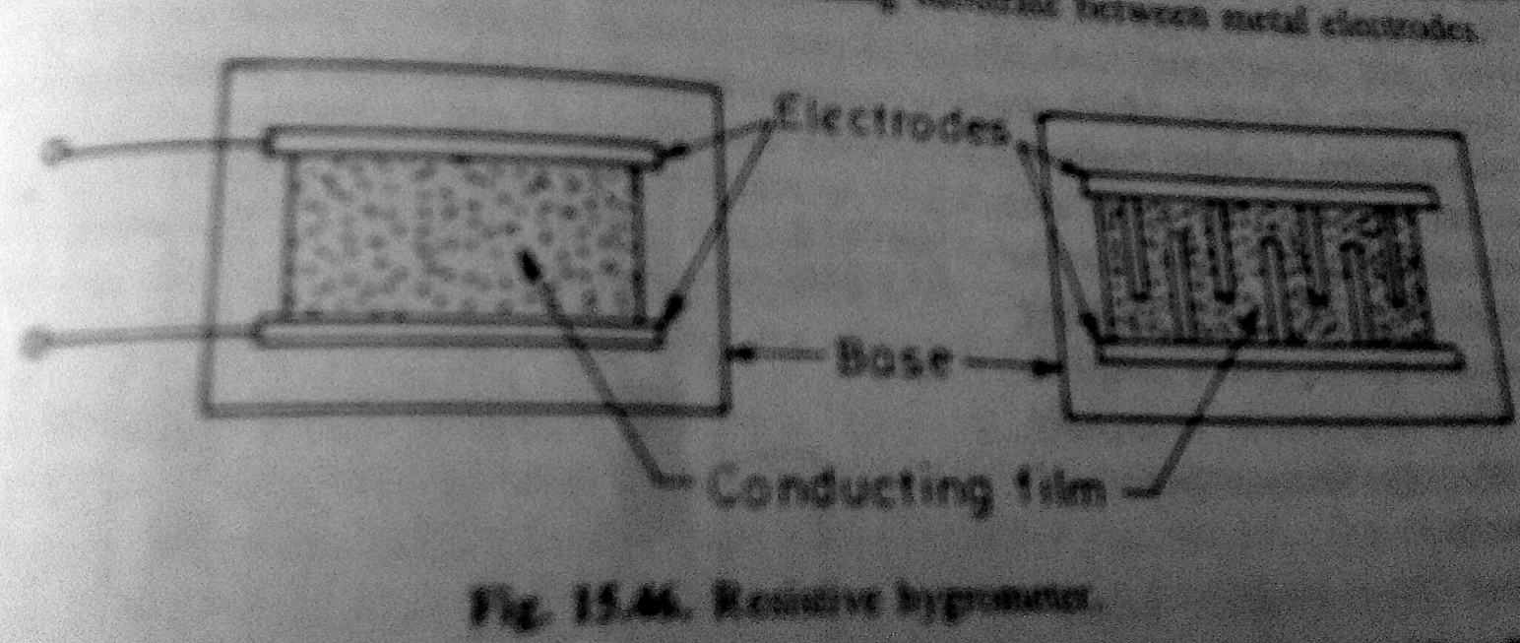
Resistive hygrometer

Slide 7
Some hygroscopic salts exhibit a change in resistivity with humidity
A typical resistive hygrometer is shown in fig..It shows a mixture of lithium chloride and carbon which acts as conducting film.
This is put on a insulating substrate between metal electrodes
The resistance of the element changes when it is exposed to variations in humidity
The higher the relative humidity, the more moisture lithium chloride will absorb and lower will be its resistance
Resistance is measured by applying a.c. to wheatstones meter bridge.The measure of the current flow is the measure of humidity.

Slide 8
Capacitive hygrometer
Some hygroscopic materials exhibit change in dielectric constant with humidity
The changes are small , and the change in capacitance is usually measured by includingit as the frequency-determining element in an oscillator.

Slide 9
Microwave refractometer
A system consisting of two cavities , each of which is coupled to a klystron, may be employed
One cavity contains dry air, the other contains the mixture to be measured.
The difference in dielectric constant is measured electronically

Slide 10
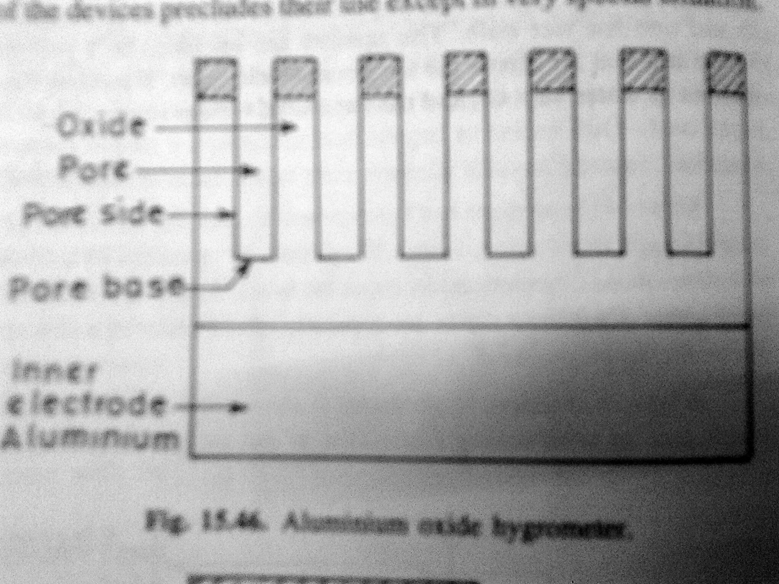
Aluminium oxide hygrometer

Slide 11
The al oxide coating on anodized aluminium exihibits a change in dielectric constant and resistivity with a change in humidity
A base of aluminium is used as one electrode and depositing a thin electrode,usually gold,on the opposite side of the oxide
This electrode is porous to air-vapour mixture
The resulting changes in resistance and capacitance lead to complex impedance changes,which are measured with a bridge or related methods

Slide 12
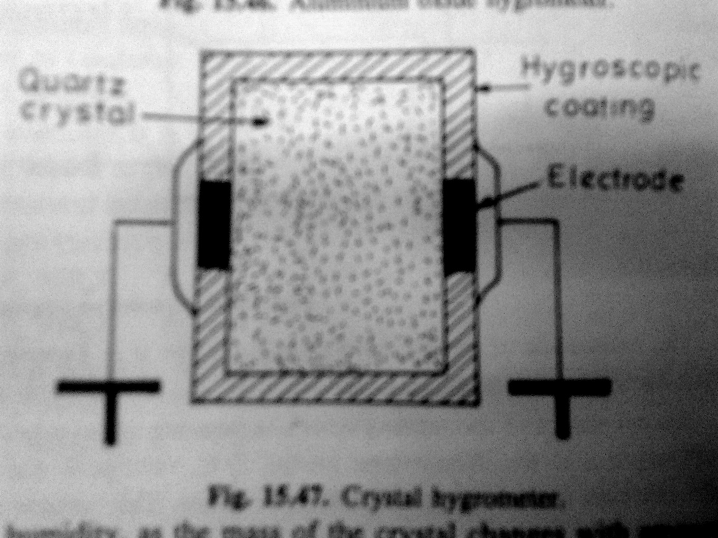
Crystal hygrometer

Slide 13
Some crystals are hygroscopic, and others may be coated with a hygroscopic material.
The crystals are used as frequency determination elements.
Frequency shifts with humidity, as the mass of crystal changes with amount of water absorbed by coating, are electronically measured.

